Slide 1
Data Analytics & Visualization
T.E. AI and DS - Jan 2023
Dr. M. Vijayalakshmi

Slide 2
Module 1- Introduction to Data analytics and life cycle
Data Analytics Lifecycle overview:
Key Roles for a Successful Analytics project
Analytics, Background
Overview of Data Analytics Lifecycle Project

Slide 3
Why – Data Analytics
Activities around the globe generate vast volumes of data daily, in the form of log files, web servers, transactional data, and various other data.
In addition to this, social media websites also generate enormous amounts of data.
There is a need to use all of this generated data to derive value out of it and make impactful decisions.
Data analytics is used to drive this purpose.
Data analytics is the process of exploring & analyzing large datasets to find hidden patterns, unseen trends, discover correlations, & derive valuable insights to make predictions.

Slide 4
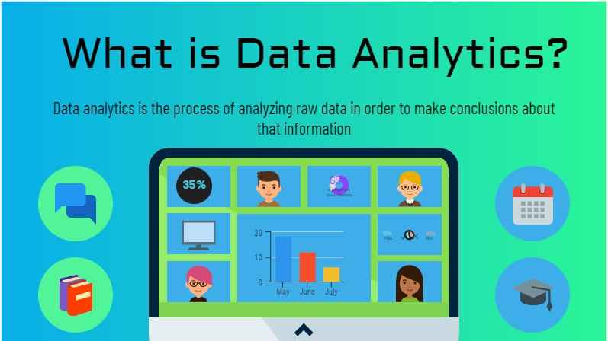

Slide 5
Data Analytics – Data Science
Data analytics is the science of analyzing raw datasets in order to derive conclusions.
It enables us to discover patterns in the raw data and draw valuable information from them.
Data science is the field, which focuses on everything related to data cleansing, preparation, and analysis.
It also copes with both unstructured and structured data.
It is the integration of mathematics, statistics, programming, data capturing, problem-solving, the capability of looking at problems in a different way, as well as the things like cleaning, preparing, and aligning data.

Slide 6
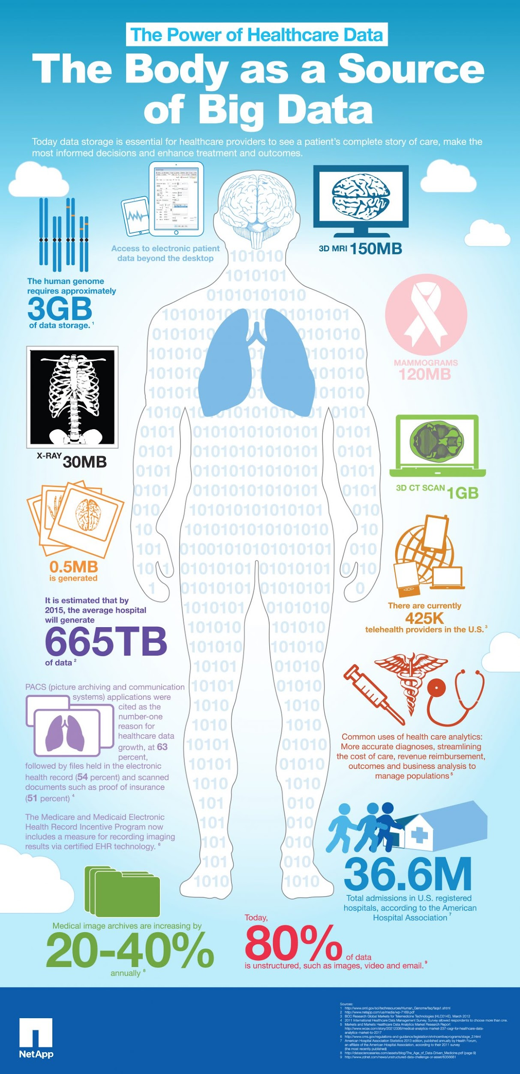

Slide 7
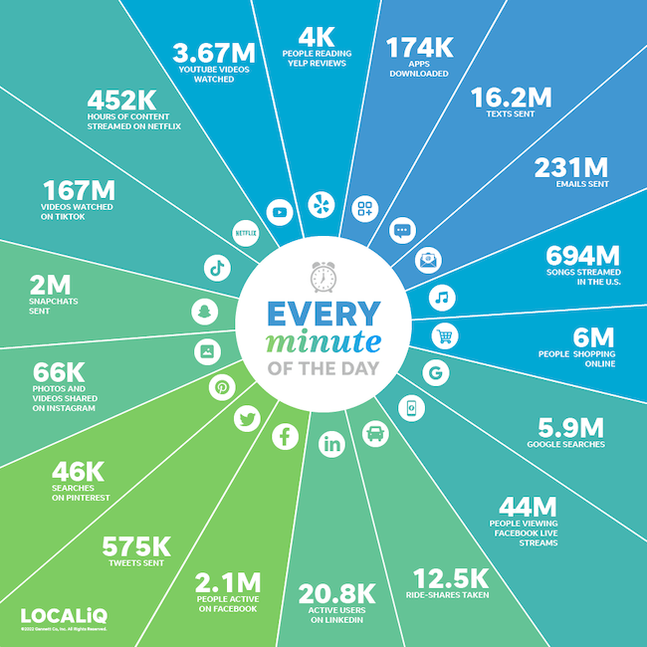

Slide 8
Key Data Creation Statistics 2023
1GB of data can create 350,000 emails.
3.5 quintillion bytes of data is created every day.
Skype has 3 billion minutes of calls per day.
5 billion Snapchat videos and photos are shared per day.
333.2 billion emails are sent per day.
20% of people online watch online games.
Revenue from Bing is over $7 billion.
People spend $1 million per minute online.

Slide 9
Size of Data
Megabyte | 1000² | MB
Gigabyte | 1000³ | GB
Terabyte | 1000⁴ | TB
Petabyte | 1000⁵ | PB
Exabyte | 1000⁶ | EB
Zettabyte | 1000⁷ | ZB
Yottabyte | 1000⁸ | YB
How much data is created every day in 2023? 3.5 quintillion bytes of data is created every day.

Slide 10
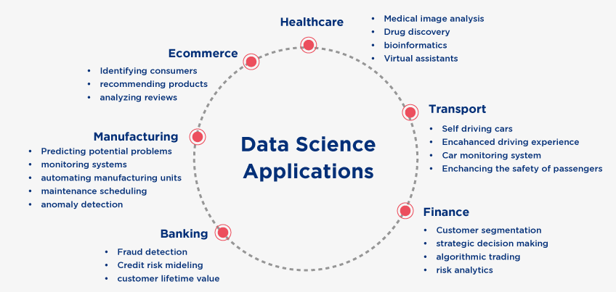

Slide 11
Real Life Applications – Case Studies

Slide 12
1. Security
Data analytics applications or, more specifically, predictive analysis has also helped in dropping crime rates in certain areas.
In many major cities, historical and geographical data has been used to isolate specific areas where crime rates could surge.
On that basis, while arrests could not be made on a whim, police patrols could be increased.
Thus, using applications of data analytics, crime rates dropped in these areas.

Slide 13
1. Security - India
Inauguration of Crime and Criminal Tracking and Network Systems (CCTNS) - Predictive Policing
National Crime Records Bureau (NCRB) contains key information which can be analysed to predict crime patterns and devise prevention strategies.
GIS Based Crime Mapping and Analysis: A Case Study of Mudugiri Town Police Station Jurisdiction, Tumkur District, Karnataka, India.
https://www.sentinelassam.com/editorial/data-analysis-as-tools-of-crime-management-582421

Slide 14
2. Transportation
Through data analytics it’s possible to improve vehicle performance, reduce costs, improve processes, establish strategies, optimize routes and times, and foresee and identify problems, among others.
Transportation analytics takes a variety of data ecosystems, helping industry leaders to use advanced analytical techniques such as machine learning, Big Data and geospatial data to optimize business strategies in the sector.
Predictive analytics in enterprises can answer questions such as “What is the most efficient route to effective distribution?”
Foreseeing from events that may affect transportation such as weather, road closures, strikes, maintenance, traffic, risk zones and estimate the impact of development projects to help identify an alternative project without obstructing mobility.

Slide 15
2. Transportation India
A mix of real-time traffic data, weather updates, and longer-term averages such as time taken, average speeds, etc., are factored in to determine the routes that will deliver maximum fuel and time efficiency. Intelligent route modelling alone has the potential of reducing a sizable percentage of emissions per vehicle per trip.
Tamil Nadu used a web-enabled GIS-based Road Accident Database Management System (RADMS), a ‘first of its kind’ system which maps road crashes, identifies the most crash-prone hot spots, and pinpoints corrective action, and has now been adopted as the template for replication at a national level for all other states.

Slide 16
2. Transportation India
Haryana Vision Zero (HVZ) was a programme launched in 2017, organised by the Haryana Government, in collaboration with WRI India, NASSCOM and Raahgiri Foundation.
Loosely modelled after ‘Vision Zero’ in Sweden, the project was aimed achieving zero road fatalities in Haryana.
Under HVZ, a team of road safety experts collaborated to analyse the data associated with road fatalities in a particular district and then audit stretches to identify whether human errors, engineering errors, or lack of infrastructure were the causes behind such incidents.
The recommendations based on these analyses were sent to the public bodies concerned to implement the changes required.
Using the data became an effective way of identifying blackspots, organising road safety awareness campaigns and introduce the necessary measures such as e-challaning and building of dedicated pedestrian infrastructure in concerned areas that required them.

Slide 17
3. Advanced Personalization
Millions of users utilize smartphones, smartwatches, and other electronic devices worldwide. They all produce enormous amounts of data. Businesses use this data to tailor different actions on the product or app to increase sales. Based on user information and behavior, personalization has a limitless future.
For instance, shopping sites like Amazon and Flipkart provide products depending on consumers' preferences, tastes, and genres. The software includes data analysis and machine learning models that automatically recognize user characteristics and show them product preferences accordingly.

Slide 18
4. Healthcare
1. Medical Image Analysis
2. Genetics & Genomics
3. Drug Development
4. Virtual assistance for patients and customer support
5. Precision Medicine
^. Prediction of new disease and spread

Slide 19
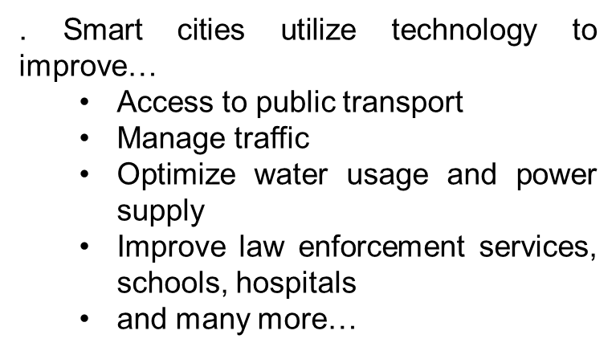
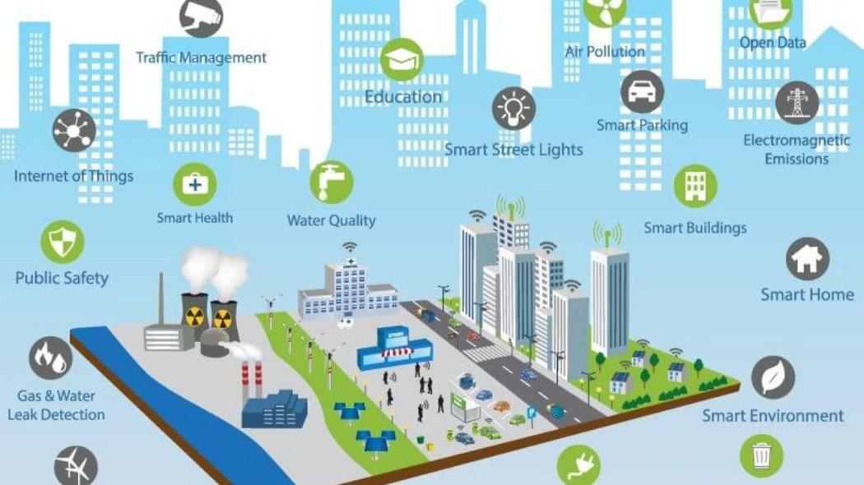
5. Smart Cities

Slide 20
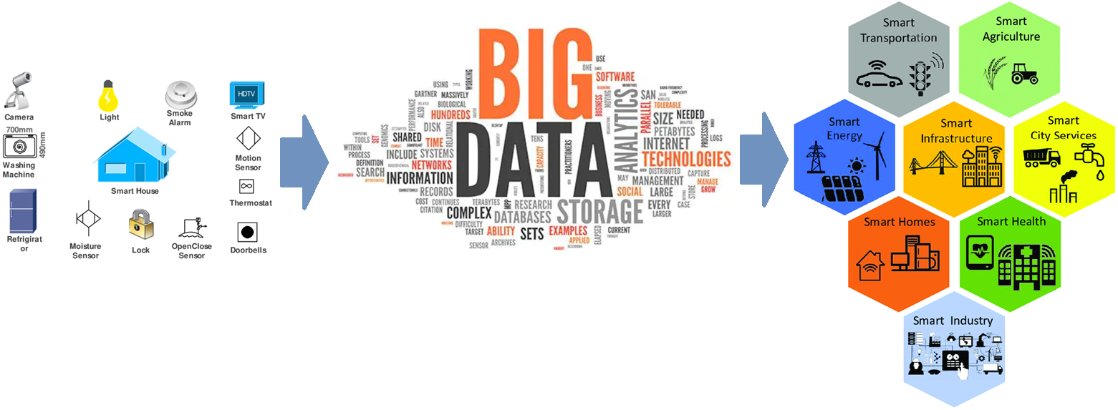

Slide 21
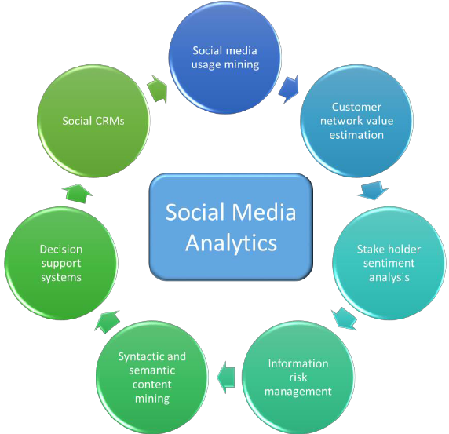
6. Social media

Slide 22
Innovative Case Studies – Real Time Data
When digging into data in search of insights, it's better to know what's going on right now – rather than yesterday, last week, or last month. This is why real-time data is increasingly becoming the most valuable source of information for businesses.
Working with real-time data often requires more sophisticated data and analytics infrastructure, which means more expense, but the benefit is that we’re able to act on information as it happens.
This could involve analyzing clickstream data from visitors to our website to work out what offers and promotions to put in front of them, or in financial services, it could mean monitoring transactions as they take place around the world to watch out for warning signs of fraud.
Social media sites like Facebook analyze hundreds of gigabytes of data per second for various use cases, including serving up advertising and preventing the spread of fake news.
And in South Africa’s Kruger National Park, a joint initiative between the WWF and ZSL analyzes video footage in real-time to alert law enforcement to the presence of poachers.

Slide 23
Top 10 of 2022
1 Your recommendations
2 How does picture recognition work?
3 Data science has transformed gaming
4 What impact does it have on education?
5 Tracking locations
6 Advertising makes use of analytics
7 Your media needs are controlled by it
8 In what ways does it benefit sports?
9 It has improved healthcare
10 Banking is made easier with it
11. environmental, social, and governance (ESG) - Driving Sustainable Innovations: Data Analytiucs for ESG Data Challenges

Slide 24
Data Analytics For Good
Predicting Covid spread vaccine etc
Fake Information identification
Climate change, Disaster reporting
Data Analytics for wildlife protection, ocean cleanup etc (Distance Earth program using Digital Twins)
Agriculture

Slide 25
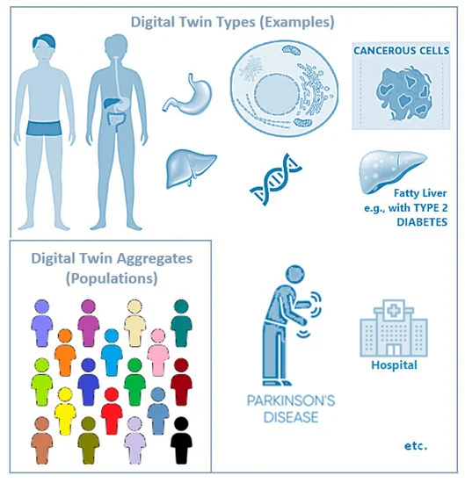
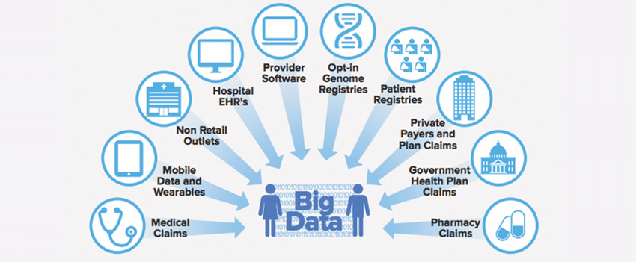
Health Analytics

Slide 26
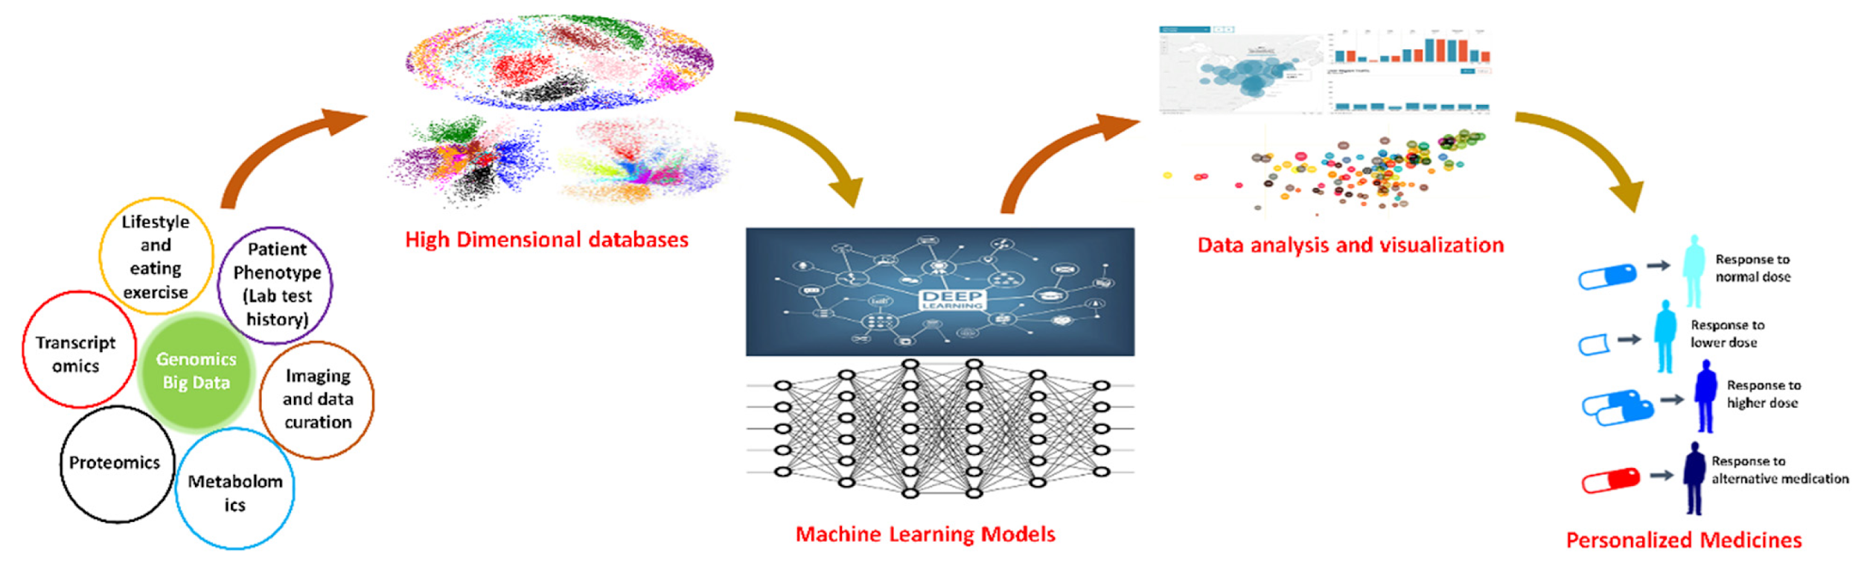
Precision medicine

Slide 27
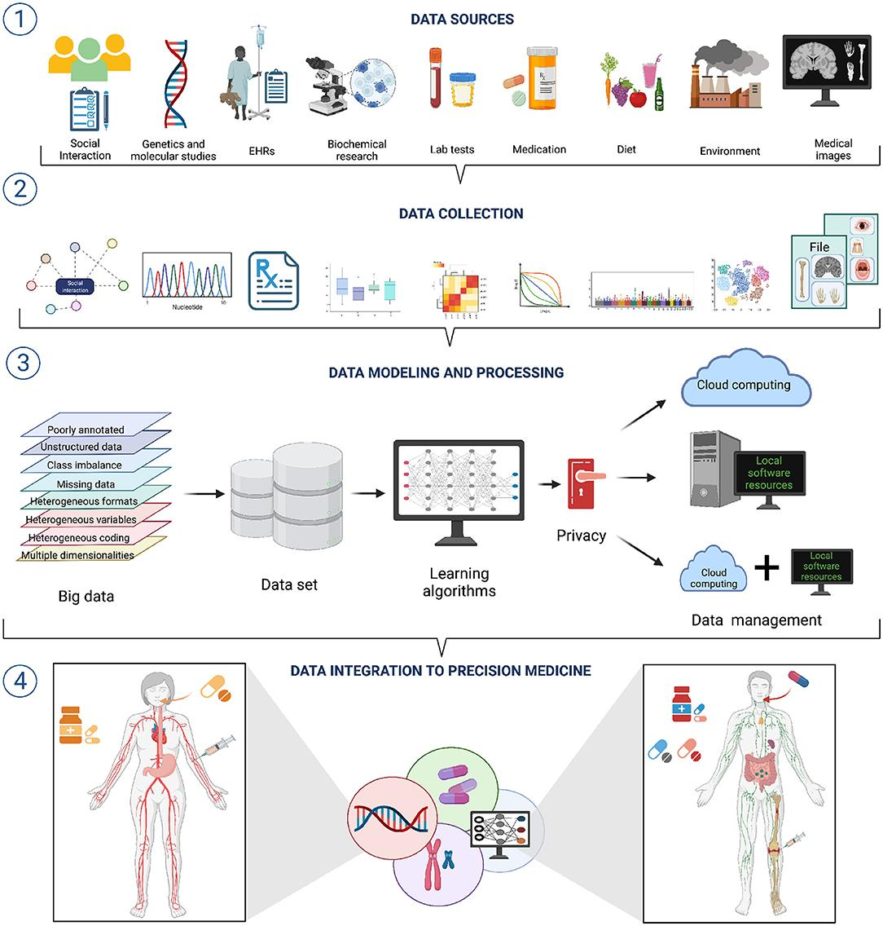

Slide 28
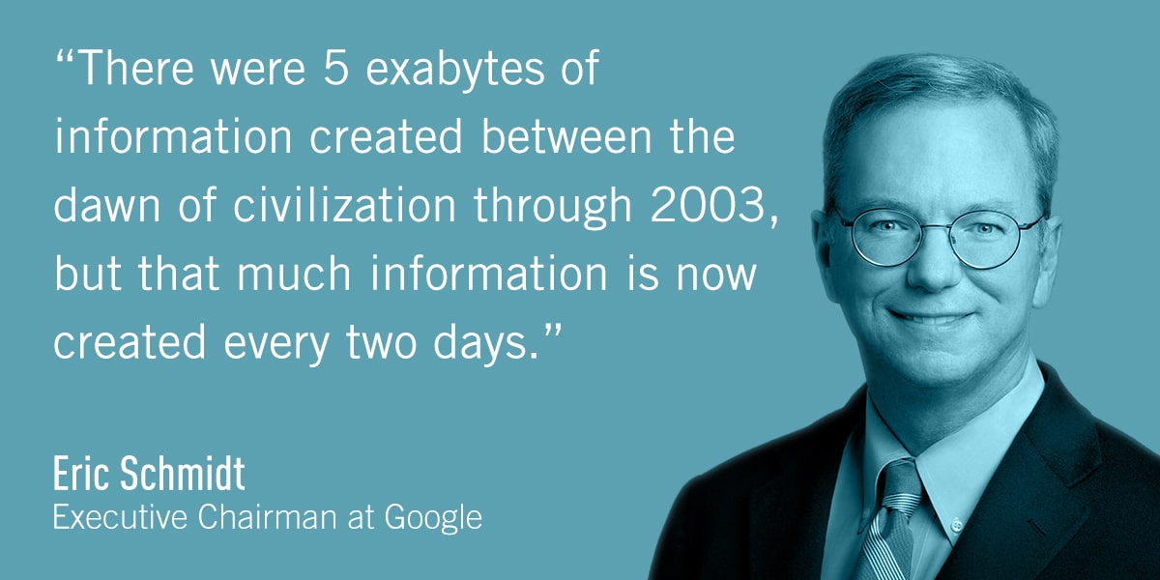
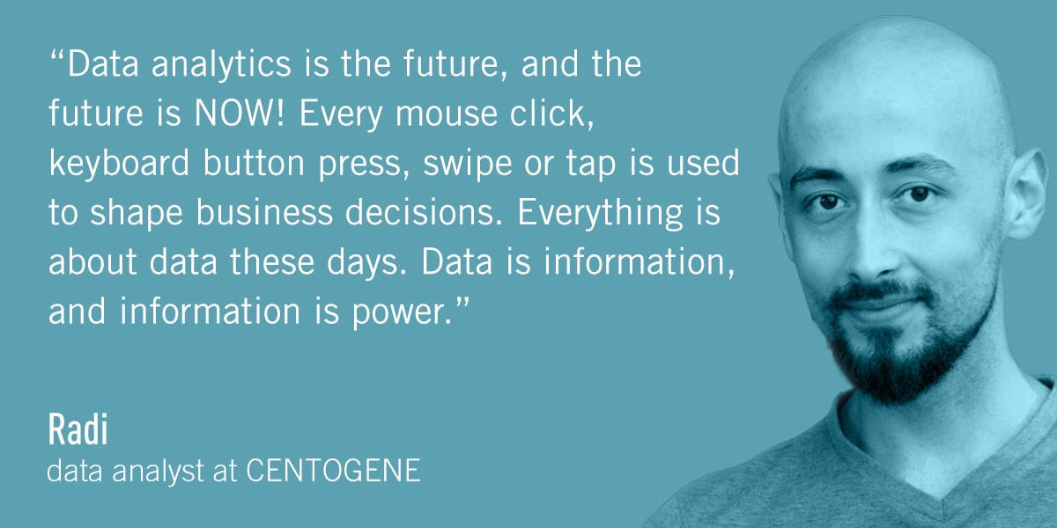
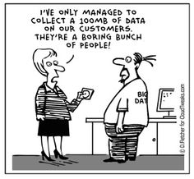
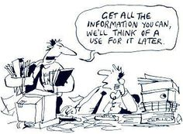

Slide 29
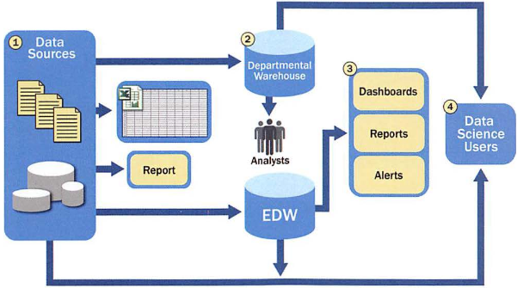
Current Analytical Architecture

Slide 30
Current Analytical Architecture
Data sources must be well understood
EDW – Enterprise Data Warehouse
From the EDW data is read by applications
Data scientists get data for downstream analytics processing

Slide 31
Emerging Data Ecosystem-New Analytics Approach
Four main groups of players
Data devices
Games, smartphones, computers, etc.
Data collectors
Phone and TV companies, Internet, Gov’t, etc.
Data aggregators – make sense of data
Websites, credit bureaus, media archives, etc.
Data users and buyers
Banks, law enforcement, marketers, employers, etc.

Slide 32
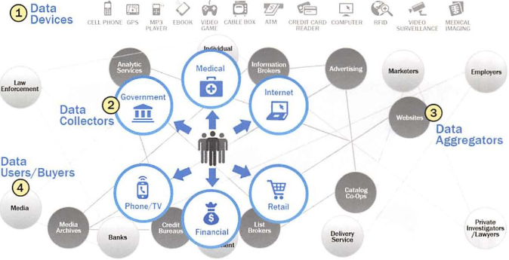
Emerging Data Analytics Ecosystem

Slide 33
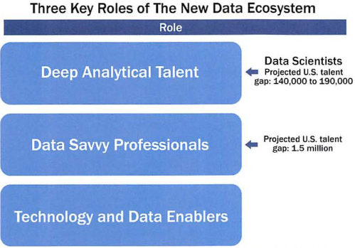
Key Roles for the New Data Analytics Ecosystem
Deep analytical talent
Advanced training in quantitative disciplines – e.g., math, statistics, machine learning
Data savvy professionals
Savvy but less technical than group 1
Technology and data enablers
Support people – e.g., DB admins, programmers, etc.

Slide 34
Recurring Data Analytics Activities
Reframe challenges and problems in the system as analytics challenges
Design, implement, and deploy statistical models and data mining techniques on Data
Develop insights that lead to actionable recommendations

Slide 35
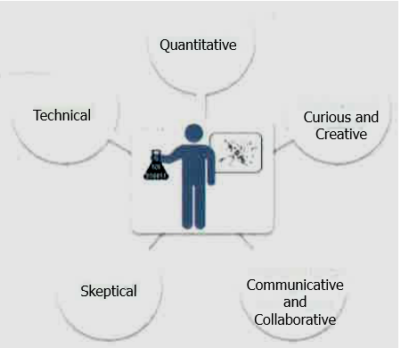
Profile of Data Analytics - 5 Main Skills
Quantitative skill – e.g., math, statistics
Technical aptitude – e.g., software engineering, programming
Skeptical mindset and critical thinking – ability to examine work critically
Curious and creative – passionate about data and finding creative solutions
Communicative and collaborative – can articulate ideas, can work with others

